Slide 1
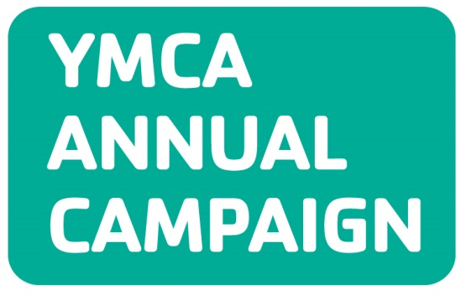
2016 Park Cities Family YMCA

Slide 2
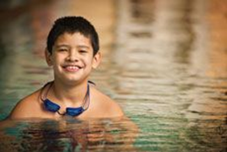
Our Y Story Or, why we spend our time helping out!
Every year, about 70 children drown in Texas. Studies show that minority children are especially at risk, as almost 60% do not know how to swim and are three times more likely to drown. As a result, The Park Cities YMCA is bringing water safety awareness to minority communities in the Love Field area, through an urban swim program called “Make A Splash.”
Ches Hudel has dedicated much of her life to helping children with mental and physical challenges learn to swim. This began when she volunteered as a college student to help a child with cerebral palsy learn to swim. Now approaching 82, Ches Hudel teaches swimming to more than 40 students in a program called Adaptive Aquatics at the Park Cities Family YMCA.
These are just two Park Cities Family YMCA stories. What is YOUR Y story?
The Y makes accessible the support and opportunities that empower people and communities
with a focus on Youth Development, Healthy Living, & Social Responsibility.

Slide 3
100% of YOUR Annual Campaign Donations provide scholarships, subsidies and support for Park Cities Family YMCA Programs No one is ever turned away because of the inability to pay!

Slide 4
The Power of Teamwork makes it possible!
Campaigners
Team Captains
Division Leaders
Co-Chairs
Jason Piering
Saffie Farris

Slide 5
Division Leaders Recruit 5 team captains to lead & motivate
Herschel Hodges Advanced Gifts
John Reniger
Commercial
Chris Crocker
Youth & Government
Kendra Yanchak
Guides & Princesses
Bryan Reinke
Sports
Angie Carlson
Wellness
Saffie Farris
Membership
Deborah Griffin
Christian Initiatives
Chris Axley

Slide 6
Team Captains Recruit 5 volunteer campaigners to support & inspire Solicit donations and raise awareness to support the programs, scholarships and subsidies of the Park Cities Family YMCA.
Campaigners
Share the impact of the Y with 4-5 other people (donors!)
Solicit donations and raise awareness to support the programs, scholarships and subsidies of the Park Cities Family YMCA.
WE are all campaigners! Campaigners are the Y’s best storytellers. Due to YOUR work, no one is turned away because of an inability to pay!

Slide 7
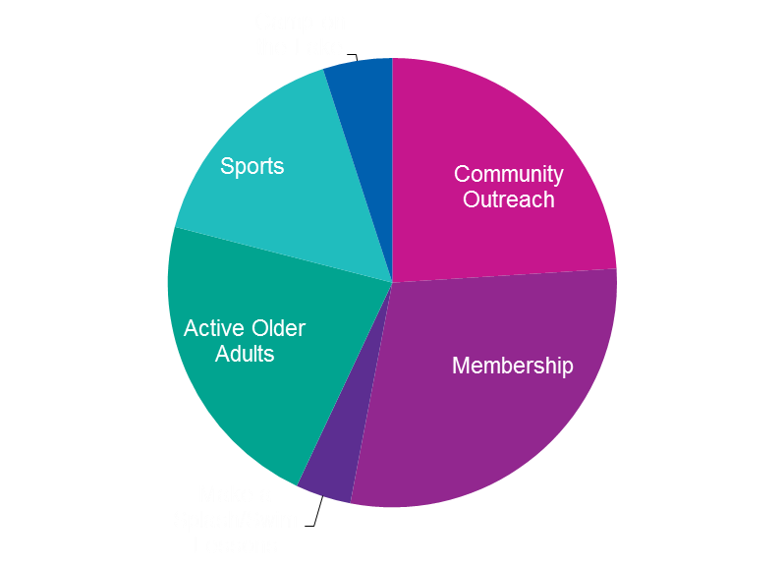
Our 2016 Goal is $435,000

Slide 8
6 Steps to a Successful Ask
1. Know The Y story, develop Your Y Story
Share with enthusiasm
2. Make your own donation first
Your commitment will prepare you to convincingly talk to your prospects
3. Build your initial contact list
Start with your friends and family (perfect your pitch here!)
Then add neighbors, business associates, customers, social groups, child’s sports team, scouts and church groups
4. Talk to your new prospects in person
Face-to-Face gives you the best opportunity to naturally share YOUR Y story
Typically, gifts are larger in person
5. Ask for a specific amount
People like to know what size gift they should consider giving
6. Attend Phone Parties, Report Meetings, and Celebrations
Be involved and active! Strive to achieve and exceed your goal

Slide 9
6 Steps to Complete your Pledges
Fill out your pledge card.
Confirm name, address, email and phone.
Confirm pledge amount.
Confirm how they want to be billed.
Email above information to Stacy Wells within 24 hours of pledge.
Turn in completed pledge cards to the branch by February 24, 2016.
Important Note: It is best for divisions to submit potential prospects to Stacy Wells at swells@ymcadallas.org. We do not want prospects to be targeted by multiple campaigners. Past donation history can be provided to assist with your ask too!

Slide 10
Important Dates
Campaigner Training
Tuesday, January 5, 2016 at 12:00pm at PCYMCA
Wednesday, January 6, 2016 at 5:30pm at PCYMCA
Thursday, January 7, 2016 at 7:30am at PCYMCA
Campaign Kickoff | Thursday, January 14, 2016 | 5:30-7:30pm at Bowlounge
Calling Parties
Tuesday, January 19, 2016 from 5:30 to 7:00pm at PCYMCA
Tuesday, January 26, 2016 from 5:30 to 7:00pm at PCYMCA
Tuesday, February 2, 2016 from 5:30 to 7:00pm at PCYMCA
Tuesday, February 9, 2016 from 5:30 to 7:00pm at PCYMCA
Tuesday, February 16, 2016 from 5:30 to 7:00pm at PCYMCA
Tuesday, February 23, 2016 from 5:30 to 7:00pm at PCYMCA
Report Meetings
Thursday, February 4, 2016 at 7:30am at PCYMCA
Thursday, February 26, 2016 at 7:30am at PCYMCA
Victory Celebration | Thursday, March 3, 2016 at TBA

Slide 11
Park Cities Family YMCA 2016 Calling Parties 5:30 to 7:00pm at PCYMCA
January 19 Dinner from Bubba’s
January 26 Dinner from Banditos
February 2 Dinner from Jason’s Deli
February 9 Dinner from Rusty Taco
February 16 Dinner from Corner Bakery
February 23 Dinner from Blue Mesa Grill
Prizes awarded for:
Most Money Raised
Most Calls Made
Door Prizes (for fun!)

Slide 12
Campaign Awards
Herschel Hodges Advanced Gifts
Top Worker | Most Money Raised
Commercial Division
Top Worker | Most Money Raised
Community Divisions
Top Division Leader by % of goal
Most Money Raised by a Division Leader
Youth & Government Teen Division
Most Money Raised
Most Points Earned
Team Spirit Award
Community Team Awards
Top Team by % of goal
Most Money Raised by a Team
Campaigner Awards
Top Worker - Most Money Raised
Top New Worker – Most Money Raised
Most # of Donations/Gifts
Team Spirit Award

Slide 13
Awards
Park Cities Family YMCA
5 Personal Training Sessions (With Dinah)
Park Cities Family YMCA
1 Year Family Membership
Exhale Spa
$150 Gift Card
Luke’s Locker
11 - $25 Gift Cards
Uchi
2 - $100 Gift Card
Knife at The Highland
$200 Gift Card
$200 Gift Card
Dicks Sporting Goods
$50 Gift Card
Central Market
$100 Gift Card
Signed NFL Football
Roger Staubach

Slide 14
Roger Moon rmoon@ymcadallas.org Kendra Yanchak kyanchak@ymcadallas.org Stacy Wells swells@ymcadallas.org Park Cities Family YMCA - (214) 526-7293
Questions?

